Slide 1
Software engineering module – III Requirement Engineering
Semester VI B.Tech. CSE Viswajyothi College of Engineering

Slide 2
Why is Getting Good Requirements Hard?
Stakeholders don’t know what they really want.
Stakeholders express requirements in their own terms.
Different stakeholders may have conflicting requirements.
Organisational and political factors may influence the system requirements.
The requirements change during the RE process. New stakeholders may emerge and the business environment change.

Slide 3
Requirements Engineering
Requirement: A function, constraint or other property that the system must provide to fill the needs of the system’s intended user(s)
Requirement Engineering
requirements for a product are defined, managed and tested systematically.
Adapted to the needs of the process, project, product and people doing the work.

Slide 4
Contnd..
RE may be reduced, but it is never abandoned.
RE is software engineering actions that start with communication activity and continues into the modeling activity.
Builds a bridge to design and construction.

Slide 5
Characteristics of a Good Requirement
Clear and Unambiguous
Standard structure
Has only one possible interpretation
Not more than one requirement in one sentence
Correct
A requirement contributes to a real need
Understandable
A reader can easily understand the meaning of the requirement
Verifiable
A requirement can be tested
Complete
Consistent
Traceable

Slide 6
Requirements Engineering Tasks
Inception: Establish a basic understanding of the problem and the nature of the solution.
Elicitation: Draw out the requirements from stakeholders.
Elaboration (Highly structured): Create an analysis model that represents information, functional, and behavioral aspects of the requirements.
Negotiation: Agree on a deliverable system that is realistic for developers and customers.

Slide 7
Contnd..
Specification: Describe the requirements formally or informally.
Validation: Review the requirement specification for errors, ambiguities, omissions, and conflicts.
Requirements management: Manage changing requirements.
Identify
Control
Track Requirements
Changes to Requirements

Slide 8
Inception - Initiating Requirements Engineering Process
Identifying Stakeholders
Anyone who benefits in a direct or indirect way from the system which is being developed
Recognizing Multiple Viewpoints
Working toward Collaboration
Business manager or senior technologist may make final decision

Slide 9
Contnd..
Ask “context-free” questions that establish
Basic understanding of the problem
The people who want a solution
The nature & measurable benefit of the solution that is desired, and
The effectiveness of preliminary communication and collaboration between the customer and the developer
Work Product
one- or two-page “product request

Slide 10
Elicitation
Elicit requirements from customers, users and others.
Find out from customers, users and others what the product objectives are
What is to be done
How the product fits into business needs, and
How the product is used on a day to day basis

Slide 11
Contnd..
Collaborative Requirements Gathering
Formal meeting with proper rule and agenda.
Facilitator
With a definition mechanism.
Preparation
A list of objects that are part of the environment that surrounds the system,
Other objects that are to be produced by the system,
Objects that are used by the system to perform its functions.
A list of services that manipulate or interact with the objects.
A lists of constraints and performance criteria.

Slide 12
Contnd..
Collect lists from everyone and combined.
Eliminates redundant entries, add new ideas, but does not delete anything.
Objective is to develop a consensus list in each topic area (objects, services, constraints and performance).
Based on lists, team is divided into smaller sub-teams:
Each works to develop mini-specification for one or more entries on each of the lists.
Each sub-team then presents its mini-specification to all attendees for discussion.
Addition, deletion and further elaboration are made.
Now each team makes a list of validation criteria for the product and present to team.
Finally, one or more participants is assigned the task of writing a complete draft specification

Slide 13
Contnd..
Quality Function Deployment
Translates the needs of the customer into technical requirements for software - customer voice table.
Identifies three types of requirements
Normal, Expected and Exciting requirements.
Methods
Customer interviews and observation, surveys, and examination of historical data etc.
Usage Scenarios - use cases
Identify a thread of usage for the system

Slide 14
Contnd..
Work products
A statement of need and feasibility.
A bounded statement of scope for the system or product.
A list of customers, users, and other stakeholders who participated in requirements elicitation.
A description of the system’s technical environment.
A list of requirements (preferably organized by function) and the domain constraints that apply to each.
A set of usage scenarios that provide insight into the use of the system or product under different operating conditions.
Any prototypes developed to better define requirements.

Slide 15
Elaboration
Focuses on developing a refined technical model of software functions, features, and constraints using the information obtained during inception and elicitation
Create an analysis model that identifies data, function and behavioral requirements.
It is driven by the creation and refinement of user scenarios that describe how the end-user will interact with the system.
Each event parsed into extracted.
End result defines informational, functional and behavioral domain of the problem

Slide 16
Developing Use Cases
A Use Case depicts the software or system from the end user’s point of view.
Step One – Define the set of actors that will be involved in the story
Actors are people, devices, or other systems that use the system or product within the context of the function and behavior that is to be described
Actors are anything that communicate with the system or product and that are external to the system itself
Represent the roles that people (or devices) play as the system operates
End user -play a number of different roles
Primary actors interact to achieve required system function and derive the intended benefit from the system. They work directly and frequently with the software.
Secondary actors support the system so that primary actors can do their work

Slide 17
Contnd..
Step Two – Develop use cases, where each one answers a set of questions
Who is the primary actor(s), the secondary actor(s)?
What are the actor’s goals?
What preconditions should exist before the scenario begins?
What main tasks or functions are performed by the actor?
What exceptions might be considered as the scenario is described?
What variations in the actor’s interaction are possible?
What system information will the actor acquire, produce, or change?
Will the actor have to inform the system about changes in the external environment?
What information does the actor desire from the system?
Does the actor wish to be informed about unexpected changes?

Slide 18
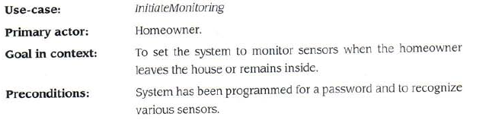
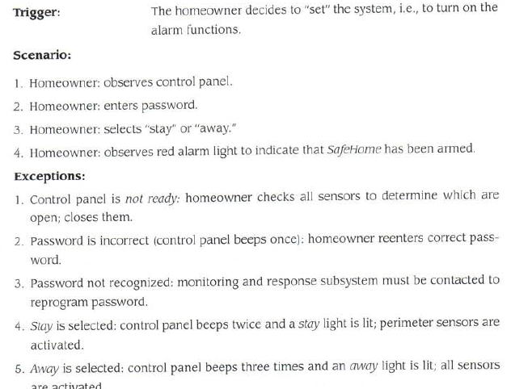

Slide 19
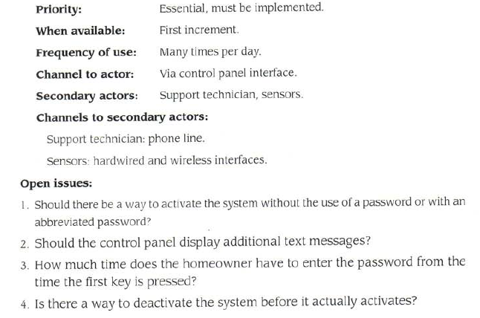

Slide 20
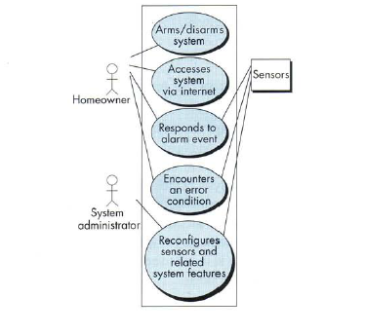
Use case Diagram

Slide 21
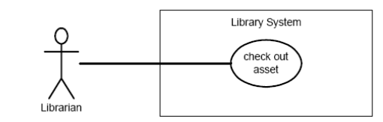
Use case Relationships
Association:
The association relationship is the interface between an actor and a use case.

Slide 22
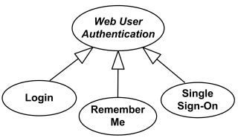
Generalization
The generalization relationship is a link between use cases.
shows that one use case is simply a special kind of another
A child can be substituted for its parent whenever necessary

Slide 23
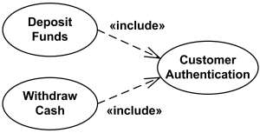
Contnd..
<<include>>
The include relationship allows one use case to include the functionality of another.
The arrow points from the use case that includes the additional functionality to the use case being included.
The include relationship is represented by a dashed line with an arrowhead.

Slide 24
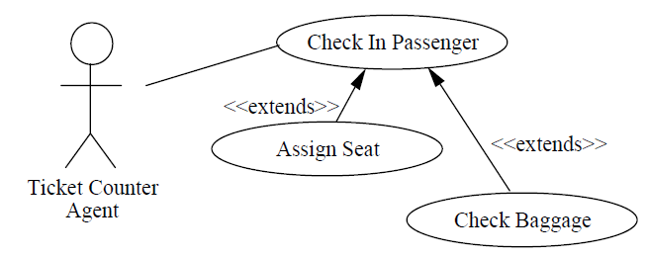
Contnd..
<<extend>>
The extend relationship combines the functionality of one use case with the functionality of another, if certain conditions exist.
Extending use case typically defines optional behavior that is not necessarily meaningful by itself.
The extend relationship is represented by a dashed line with an arrowhead.
The arrow points from the use case that provides the additional functionality to the use case that accepts the functionality.

Slide 25
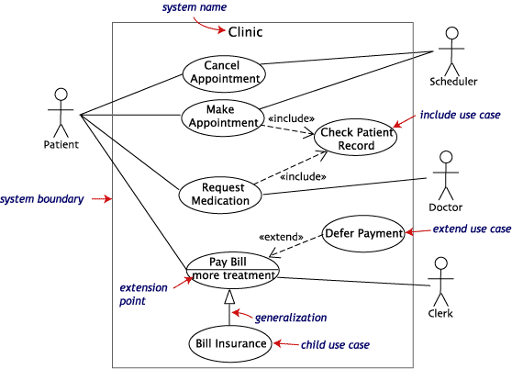

Slide 26
Building the Analysis Model
Provides a description of the required informational, functional and behavioral domains for a computer based system.
A snapshot of requirements at any given time.
The model changes dynamically;
As S/W engineers learn more about the system and
The stakeholders understand more about what they really require.
As the model evolves,
certain elements will become relatively stable, providing a solid foundation for the design task.
Other elements of the model may be more volatile, indicating that stakeholders do not yet fully understand requirements for the system

Slide 27
Contnd..
Information domain encompasses that the data flow into the system, out of the system and data stored.
Functions provide direct benefit to end-users and also provide internal support for those features that are user visible.
Behavior driven by its interaction with the external environment.

Slide 28
Types
Structured analysis
Considers data and the processes that transform the data as separate entities
Data is modeled in terms of only attributes and relationships (but no operations)
Processes are modeled to show the 1) input data, 2) the transformation that occurs on that data, and 3) the resulting output data
Object-oriented analysis
Focuses on the definition of classes and the manner in which they collaborate with one another to fulfill customer requirements

Slide 29
Elements of the Analysis Model
Scenario-based elements
Describe the system from the user's point of view.
Uses scenarios that are depicted in use cases and activity diagrams
The first part of the model that is developed.
Serve as input for the creation of other modelling elements.

Slide 30
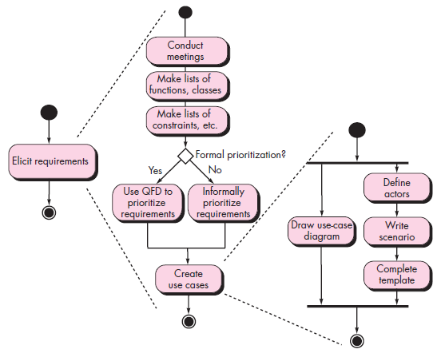
Contnd..

Slide 31
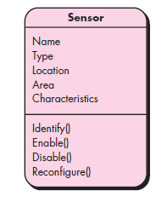
Contnd..
Class-based elements
Each usage scenario implies a set of objects.
These objects are categorized into classes.
Identify the domain classes for the objects manipulated by the actors,
The attributes of these classes.
Use other analysis modeling elements
How they interact with one another.

Slide 32
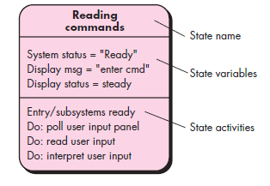
Contnd..
Behavioral elements
The behavior of a computer-based system can have a profound effect on the design and implementation.
Use state diagrams to represent
The state of the system,
The events that cause the system to change state, and
The actions that are taken as a result of a particular event.
The behavior of individual classes can also be modeled.

Slide 33
Contnd..
Flow-oriented elements
Information is transformed as it flows through a computer-based system.
The system accepts input in a variety of forms, applies functions to transform it, and produces output in a variety of forms.
Use data flow diagrams to show;
The input data that comes into a system,
What functions are applied to that data to do transformations, and
What resulting output data are produced

Slide 34
Contnd..
Object-oriented Analysis
Structured Analysis
Scenario-based
modeling
Flow-oriented
modeling
Use case text
Use case diagrams
Activity diagrams
Swim lane diagrams
Data structure diagrams
Data flow diagrams
Control-flow diagrams
Processing narratives
Class-based
modeling
Behavioral
modeling
Class diagrams
Analysis packages
CRC models
Collaboration diagrams
State diagrams
Sequence diagrams

Slide 35
Analysis Patterns
Suggest solutions within the application domain that can be reused when modeling many applications.
Class, function, behavior etc.
Uses:
Speed up the development of abstract analysis models
Facilitate the transformation of the analysis model into a design model.
Integrated into the analysis model by reference to the pattern name.
Stored in a repository so that requirements engineers can use search facilities to find and apply them.

Slide 36
Contnd..
The original author does not create a pattern.
Once discovered, document it.
Explicitly the general problem to which the pattern is applicable,
The prescribed solution, assumptions and constraints of using the pattern in practice,
Other information about the pattern, such as;
The motivation and driving forces for using the pattern,
Pattern’s advantages and disadvantages,
References to some known examples of using that pattern in practical applications.

Slide 37
Contnd..
Patterns are discovered as
That occur throughout an application domain, or
By analogy, across different application domains
A coherent set of use cases may serve as the basis for discovering one or more analysis patterns.
The most basic element in the description of a requirements model is the use case.
Semantic Analysis Pattern (SAP)
A pattern that describes a small set of coherent use cases that together describe a basic generic application.

Slide 38
Negotiating Requirements
Intention is to develop a project plan that meets stakeholder needs while at the same time reflecting the real world constraints that have been placed on the software team.
Win – Win result
Stakeholders win by getting the system or product that satisfies the majority of their needs and you win by working to realistic and achievable budgets and deadlines.
Activities
Identification of the system or subsystem’s key stakeholders.
Determination of the stakeholders’ “win conditions”.
Negotiation of the stakeholders’ win condition to reconcile them into a set of win-win condition for all concerned.

Slide 39
The Art of Negotiation
Recognize that it is not competition
Map out a strategy
Listen actively
Focus on the other party’s interests
Don’t let it get personal
Be creative
Be ready to commit

Slide 40
Specification
Specification – Different things to different people.
It can be –
Written Document
A set of graphical models,
A formal mathematical models
Collection of usage scenario.
A prototype
Combination of above.
The Formality and format of a specification varies with the size and the complexity of the software to be built.
For large systems, written document, language descriptions, and graphical models may be the best approach.
For small systems or products, usage scenarios

Slide 41
Specification Task
A specification is the final work product produced by the requirements engineer
It is normally in the form of a software requirements specification
It serves as the foundation for subsequent software engineering activities
It describes the function and performance of a computer-based system and the constraints that will govern its development
It formalizes the informational, functional, and behavioral requirements of the proposed software in both a graphical and textual format

Slide 42
Validating Requirements
During validation, the work products produced as a result of requirements engineering are assessed for quality
The specification is examined to ensure that
All software requirements have been stated unambiguously
Inconsistencies, omissions, and errors have been detected and corrected
The work products conform to the standards established for the process, the project, and the product
The formal technical review serves as the primary requirements validation mechanism
Members include software engineers, customers, users, and other stakeholders

Slide 43
Questions to ask when Validating Requirements
Is each requirement consistent with the overall objective for the system/product?
Have all requirements been specified at the proper level of abstraction? That is, do some requirements provide a level of technical detail that is inappropriate at this stage?
Is the requirement really necessary or does it represent an add-on feature that may not be essential to the objective of the system?
Is each requirement bounded and unambiguous?
Does each requirement have attribution? That is, is a source (generally, a specific individual) noted for each requirement?

Slide 44
Do any requirements conflict with other requirements?
Is each requirement achievable in the technical environment that will house the system or product?
Is each requirement testable, once implemented?
Approaches: Demonstration, actual test, analysis, or inspection
Does the requirements model properly reflect the information, function, and behavior of the system to be built?
Has the requirements model been “partitioned” in a way that exposes progressively more detailed information about the system?

Slide 45
Requirement Management
Set of activities that help project team to identify, control, and track requirements and changes as project proceeds
Requirements begin with identification. Each requirement is assigned a unique identifier. Once requirement have been identified, traceability table are developed.
Traceability Table:
Features traceability table - shows how requirements relate to customer observable features
Source traceability table - identifies source of each requirement

Slide 46
Dependency traceability table - indicate relations among requirements
Subsystem traceability table - requirements categorized by subsystem
Interface traceability table - shows requirement relations to internal and external interfaces
It will help to track, if change in one requirement will affect different aspects of the system.

